Slide 1
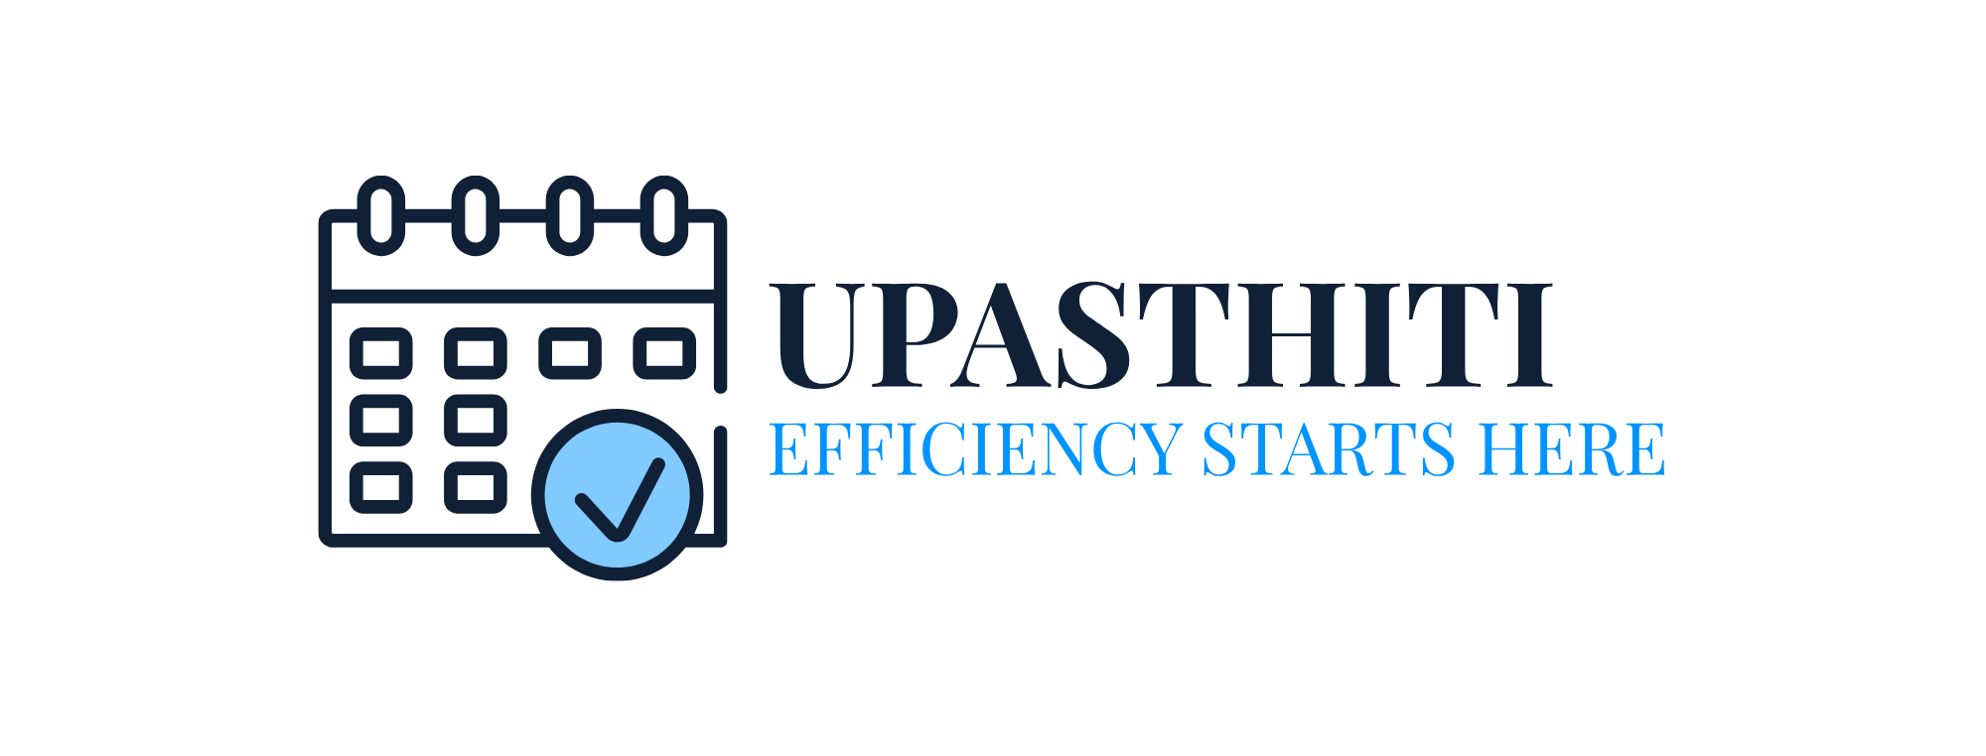

Realtime Societal Research Project
Presented By:
Pavani G-23R01A66U9
Parinita Malisetty-23R01A66X2
Keerti Madhavi S-23R01A66Y2
Bhanu Teja Goud A-24R05A6602

Slide 2
CONTENTS
Introduction
Purpose
Tech stack
Applications
Architecture
Results
Future scope
Conclusion

Slide 3

INTRODUCTION
Upasthiti is a software solution designed to track and manage student attendance efficiently. It replaces traditional paper-based or manual methods with digital solutions, ensuring accuracy, reducing errors, and saving time.
It is a web-based platform that digitalizes attendance and marks management in educational institutions. It replaces the traditional manual registers with an efficient, accessible and error-free digital system.
Its purpose is to simplify attendance tracking and academic record entry, provide real-time data access for admin and faculty as well as eliminate redundancy and human error in record-tracking.

Slide 4
PURPOSE
Automate Attendance Tracking – Records and maintains attendance without manual effort.
Improve Accuracy – Reduces errors associated with manual data entry.
Save Time & Effort – Speeds up the process of marking attendance.
Generate Reports – Provides detailed reports for analysis and decision-making.

Slide 5


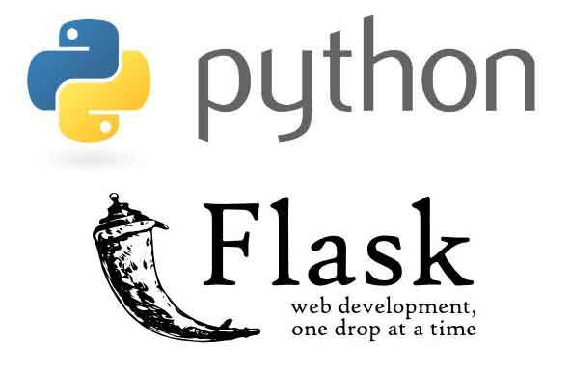

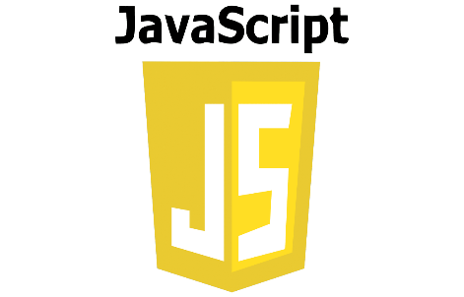

TECHSTACK
FRONTEND
BACKEND

Slide 6
APPLICATIONS
Educational Institutions – Tracks student and teacher attendance.
Corporate Offices – Monitors employee work hours and productivity.
Factories & Industries – Ensures shift management and compliance.
Healthcare & Hospitality – Manages staff schedules and reduces absenteeism.

Slide 7
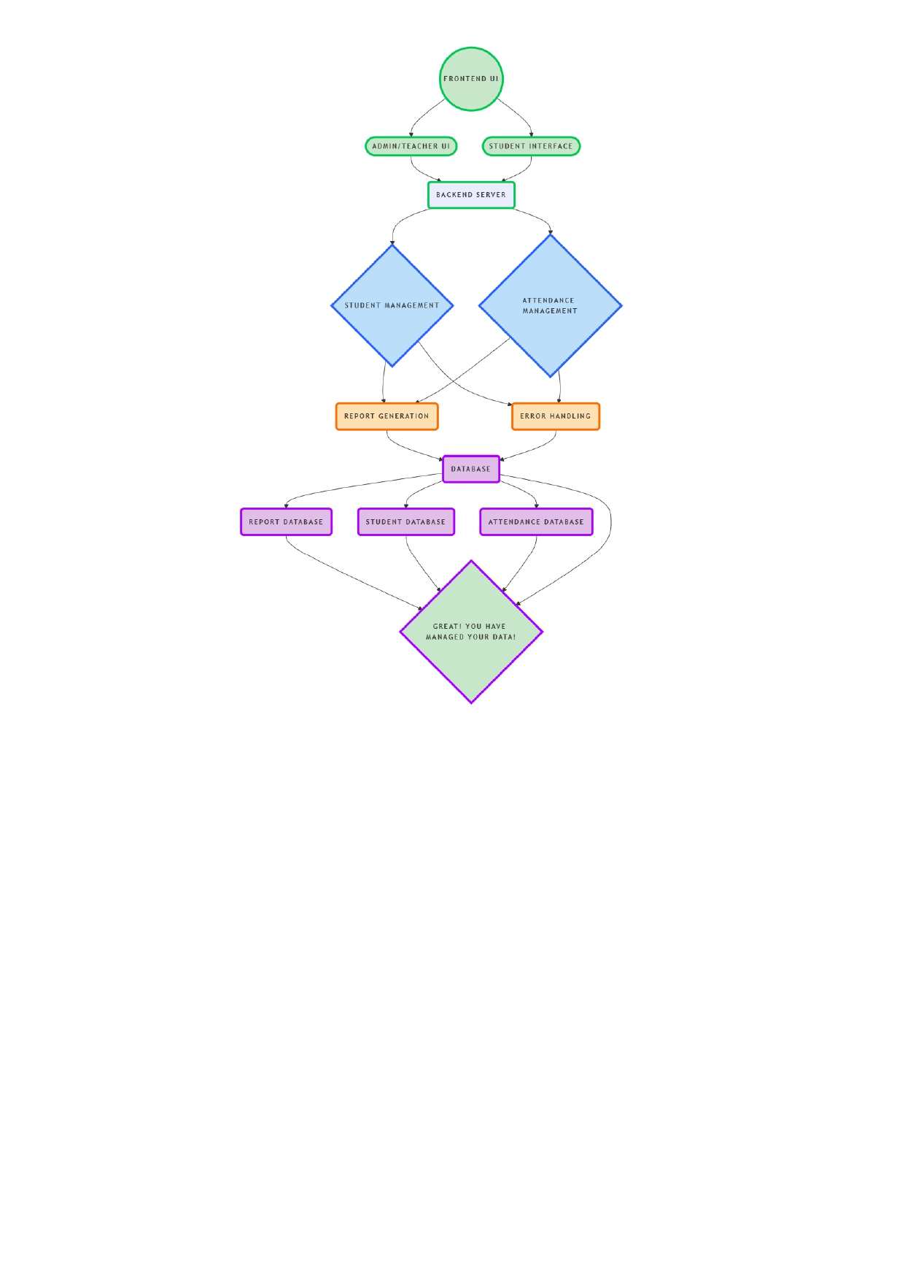
ARCHITECTURE
Frontend UI:
Admin & Student Interface
Backend Modules:
Student Management
Attendance Management
Report Generation
Database: Student DB, Attendance DB, Marks DB

Slide 8
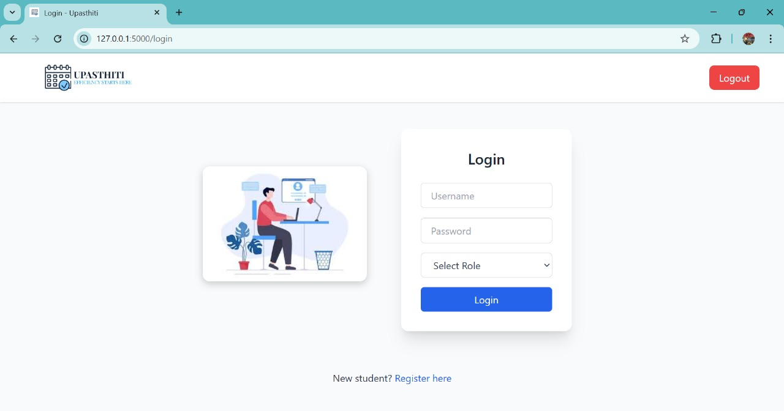
LOGIN PAGE

Slide 9
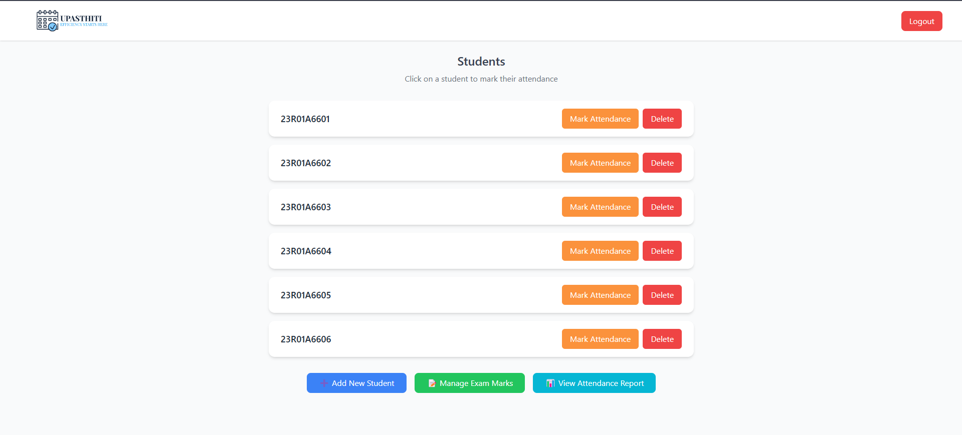
INDEX PAGE

Slide 10
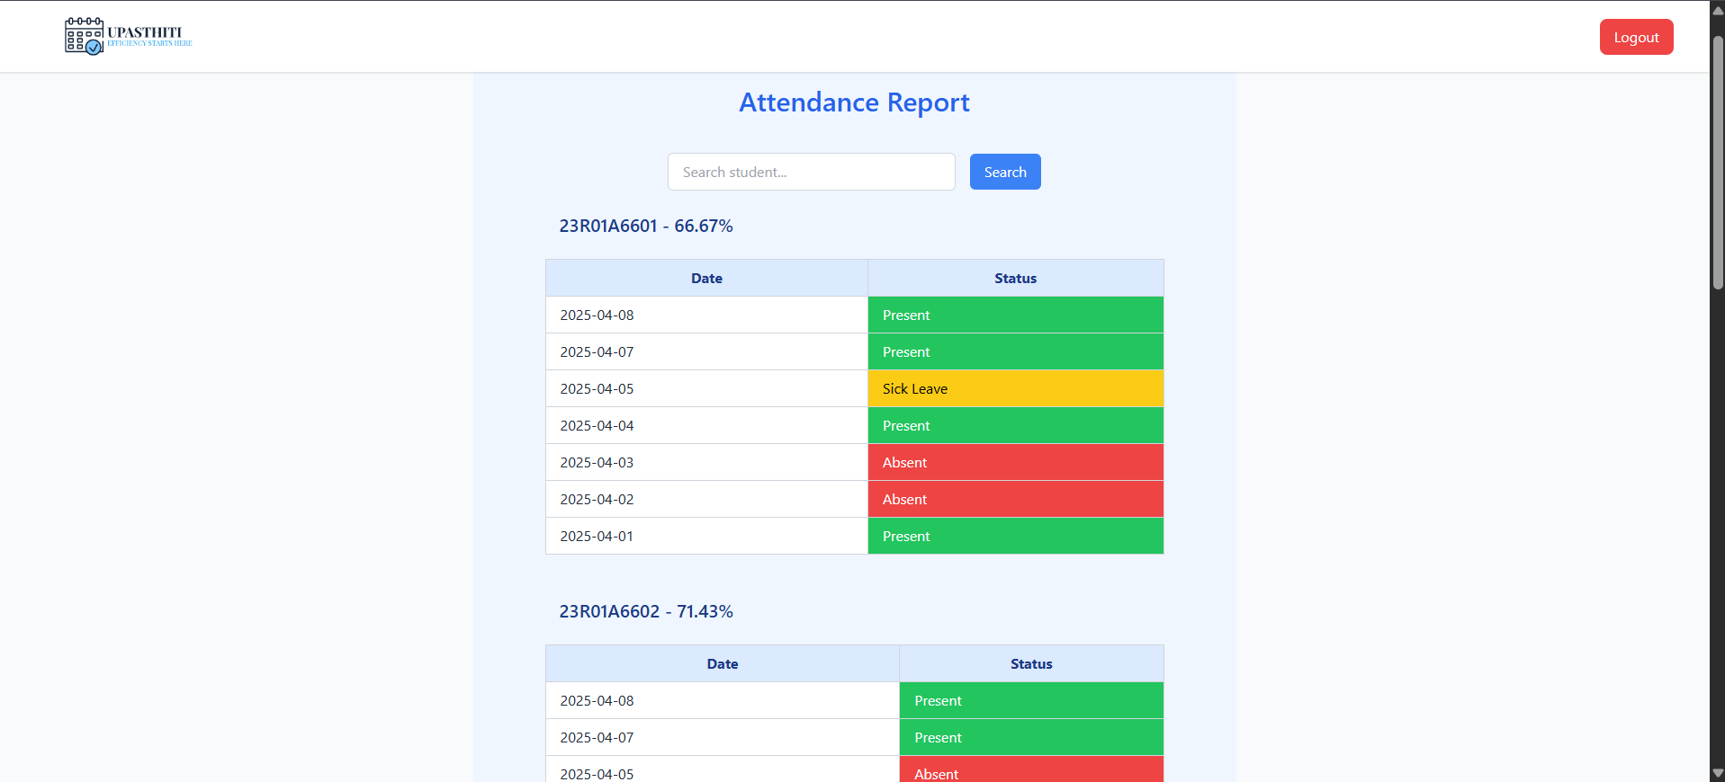
ATTENDANCE REPORT

Slide 11
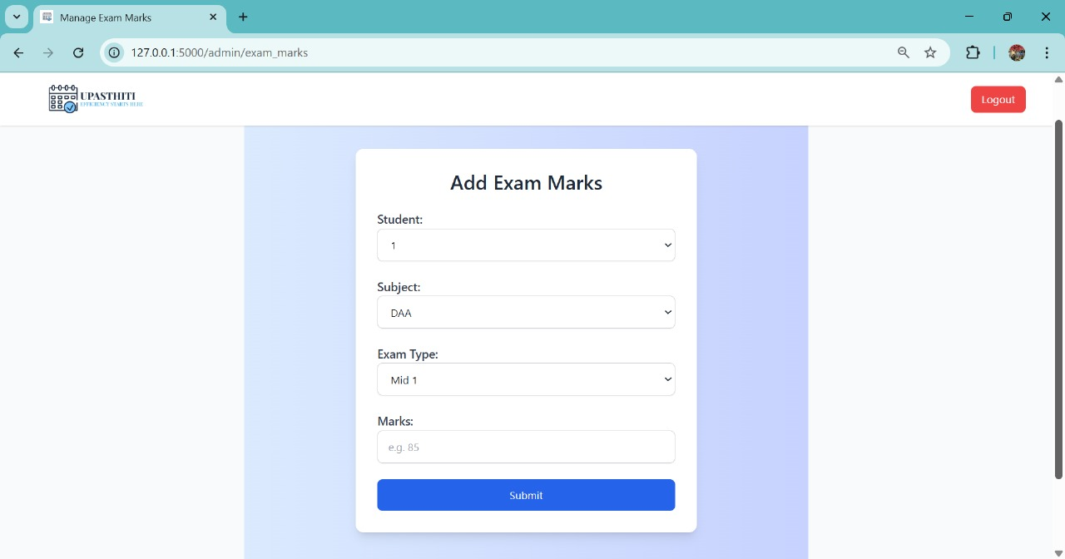
ADD EXAM MARKS

Slide 12
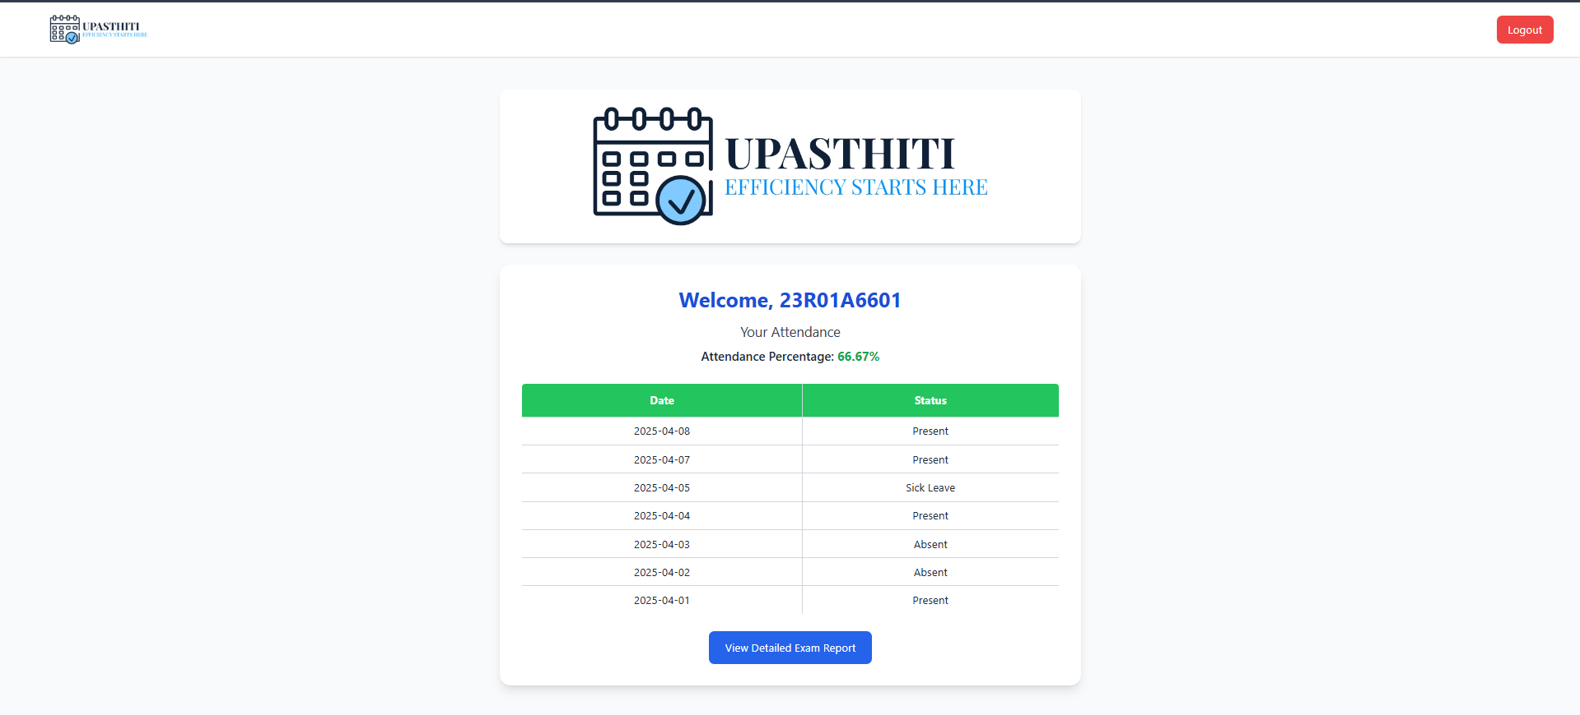
STUDENT DASHBOARD

Slide 13
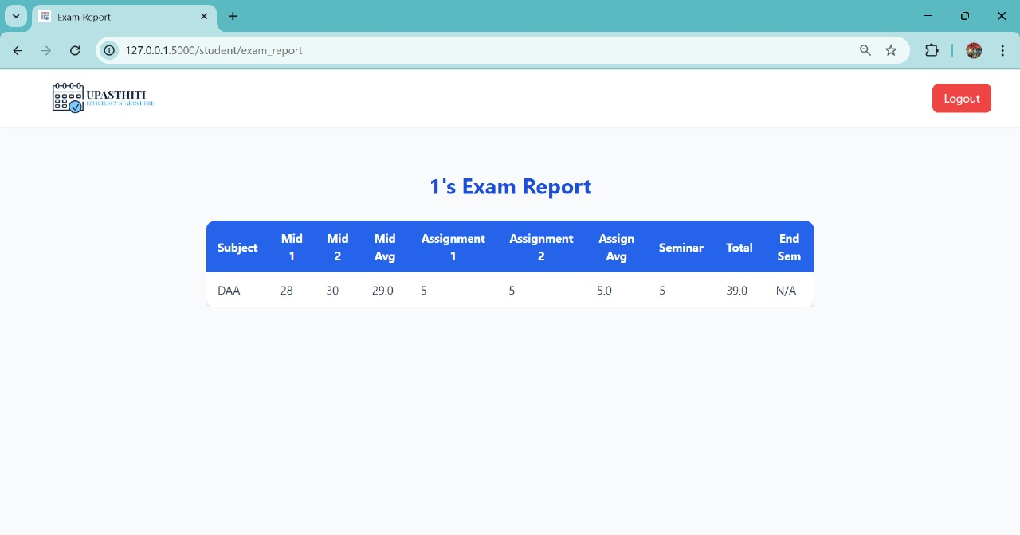
STUDENT DASHBOARD

Slide 14

FUTURE SCOPE
While Upasthiti already offers a functional student dashboard and core attendance features, several enhancements can extend its capabilities:
Scalable Database Support:
Upgrade from SQLite to more scalable systems like MySQL or PostgreSQL to support institution-wide usage.
Biometric/Facial Recognition Integration:
Implement face recognition or RFID attendance for automation and increased security in attendance tracking.
Mobile App Integration:
Develop a mobile app version (Android/iOS) for convenient access to attendance, marks, and notifications on the go.
Smart Notifications:
Like Auto-send alerts for- Low Attendance, Sick leave approvals, Upcoming exams or deadlines
Data Visualization and Analytics:
Add interactive dashboards for admins with charts showing-Attendance trends, Subject-wise performance, Student engagement.
Multi-Role Access Control:
Extend the system to allow parents, HODs, and class coordinators to view relevant data with appropriate permissions.
Export and Backup Options
Enable exporting of attendance/marks as PDFs/Excels and schedule automatic backups for data safety.

Slide 15
CONCLUSION
Upasthiti successfully modernizes the manual attendance and academic tracking system by providing a user-friendly and efficient digital alternative.
With functionalities like attendance marking, marks entry, student-wise dashboards, percentage calculations, sick leave handling, and search, it addresses the key needs of academic record management.
Its offline capabilities, admin controls, and real-time access ensure smooth operation even in resource-limited environments.
While fully functional, Upasthiti remains flexible for further enhancement, ensuring long-term value for educational institutions.
Upasthiti is not just a system, but a foundation for smarter and scalable academic administration.

Slide 16

QUERY TIME!

